Slide 1
COGS 118B Final project K-Means, PCA
Feifan Li
Binghan Shen
Rosy Xu
Xuhui Liu
Shaolong Li

Slide 2
Introduction
Dataset description
Topic
Significance of the topic

Slide 3
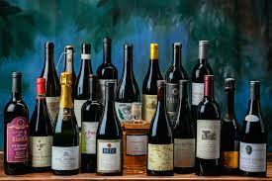
Introduction:
Our Topic
Assuming that we are a firm producing wine. Our topic is to cluster the customers by several selected features.
For each cluster, we adopt specific measures to figure out the customers’ willingness to purchase our wine products.
Is there any other patterns worth attention?

Slide 4
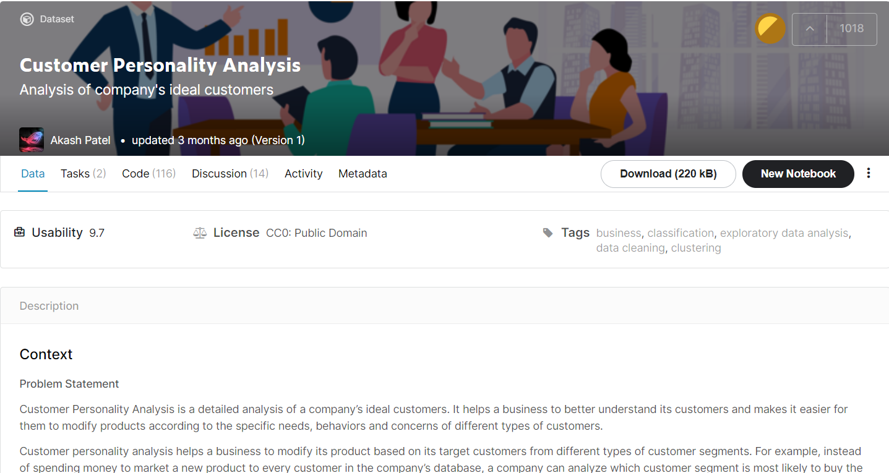
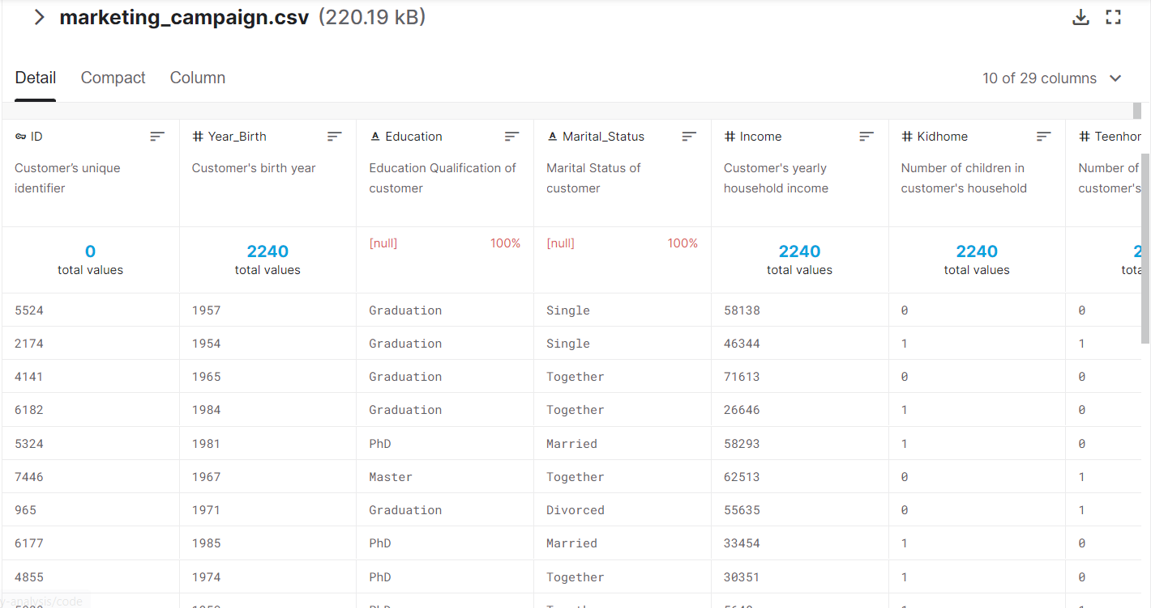
Introduction:
Dataset
Dataset we chose: https://www.kaggle.com/imakash3011/customer-personality-analysis

Slide 5
Introduction:
Dataset
Our dataset contains 2240 rows and 29 column, after cleaning , we dropped the last 19 column since we only interested in the attributes Age, Education and Income of customers. We define each column of the dataset as one dimension. Our goal is to use K-means and PCA to build a model that classifies the customers according to the attributes listed above.
Five Dimensions are selected in the classification:
Age: the age of the individual
Kids: the number of kids in the individual’s family
Teens: the number of teens in the individual’s family
Enroll_age: how long has been the individual enrolled in our firm
Rencency: Number of days since customer's last purchase

Slide 6

Introduction:
Significance of our project
What’s the problem we want to solve?
How can we make our advertisements more targeted and effective? Nowadays, in marketing field, we are always wondering that to whom we should advertise our products.
Why is it important?
It will dramatically affect the profits that our firm could obtain. We do not want to advertise the wine product to the customers that have low willingness, which costs a lot but makes little profit in return.

Slide 7
Introduction:
Significance of our project
The central aim of our project is to cluster the customers based on some features provided and figure out their willingness to purchase wine. To be specific, we categorize the customers into several groups: low willingness, middle willingness, and high willingness. After we divide the customers according to their willingness, we can send out the corresponding advertisements. Hence, from the result of this project, the company can make their advertisements more targeted and effective.

Slide 8
Related Works
What’s in common?
Paper：
Application of K-Means Algorithm for Efficient Customer Segmentation: A Strategy for Targeted Customer Services
RFM model for customer purchase behavior using K-Means algorithm
Integration K-Means Clustering Method and Elbow Method For Identification of The Best Customer Profile Cluster
These paper all illustrate the common process of applying K-means for customer segmentation:
First, they determine k by using different methods. Second, they run K-means and get several clusters. Finally, they label the clusters and observe the patterns of each cluster. In conclusion, the process is similar to ours.

Slide 9

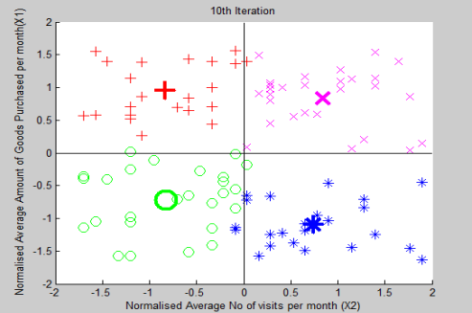
Related Works
In the paper Application of K-Means Algorithm for Efficient Customer Segmentation: A Strategy for Targeted Customer Services, the authors used K-means to classify customers based on several features such as income, which is really similar to what we did in our project. However, their k means program is trained using a z score normalized two factor dataset, which we did not do for our K means. They have four clusters after running the k-means and they labeled these four clusters as High Buyers Regular Visitors (HBRV), High Buyers Irregular Visitors (HBIV), Low Buyers Regular Visitors (LBRV) and Low Buyers Irregular Visitors (LBIV). We also labeled our clusters after running the k means but our label is not as generalized as theirs. Also, they did their k means in Matlab, which is different from what we did in python. In short, both works are trying to cluster customers based on their features using k means in order to provide more precise and targeted customer service.
http://citeseerx.ist.psu.edu/viewdoc/summary?doi=10.1.1.736.3182
Source:
http://citeseerx.ist.psu.edu/viewdoc/summary?doi=10.1.1.736.3182

Slide 10
Method
Flow chart
Description of the process
Algorithms we use(K-means and PCA)

Slide 11
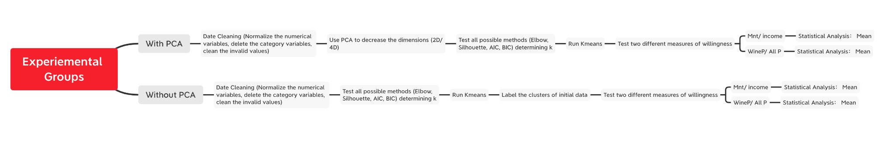

Slide 12

Classification: With PCA V.S. Without PCA
Measures: Mnt/ income V.S. Wine P/All P
Method
How we design? -- Two critical control groups

Slide 13
With PCA V.S. Without PCA
Method
How we design? -- Classification
The data set which we want to cluster is 5-D data, so we could not visualize it. In this case, determining the k would be difficult, since objective test (Elbow test, etc.) may not show an obvious result on consistency, and subjective test (directly observe the visualization) doesn’t work either because we cannot visualize a 5-D data set.
Hence, to cluster the data better, besides clustering without PCA, we adopt PCA to cluster the dataset in the other control group. In this way, we can see which one is better.

Slide 14
Mnt/ income V.S. Wine P/All P
Method
How we design? -- Measures
In order to find out the purchasing willingness of each class after unsupervised clustering, we need to develop several measures to measure the purchasing willingness. Considering the features we can get in the original data set from Kaggle, we design these two measures:
Mnt/income: the minimum expense on wine products of an individual over his/ her income.
Wine P/All P: the expense on wine products over expense on other products (i.e. fruits, meat, fish, etc.)
After classification, we will use these two measures to compute the purchasing willingness of every individual, and observe the consistency of the two results.
Hint: Data of these two measures won’t be included in the classification step!

Slide 15
Method:
algorithms
In this project, we mainly use two algorithms that are taught in class: K Means and Principal Component Analysis. We use K means to cluster the customers into separate categories by selected features. There are two main problems with Kmeans: first, we need to determine the appropriate value of K; a good K value should produce very consistent results. Another problem is which dimensions we should choose. Including or excluding different dimensions or features will produce different results.
Another algorithm that we use is Principal Component Analysis (PCA). By using it, we can reduce the dimension of our dataset, excluding the features that are least important. In the project, We run K-means on the dataset after PCA and compare its result with the one without using PCA. From this comparison, we can judge whether the use of PCA can improve effectiveness of K-means. The problem with PCA is that we need to figure out how many dimensions that we should reduce to, and this will directly affect the result of K-means.

Slide 16
Process and results
Without PCA
With PCA

Slide 17
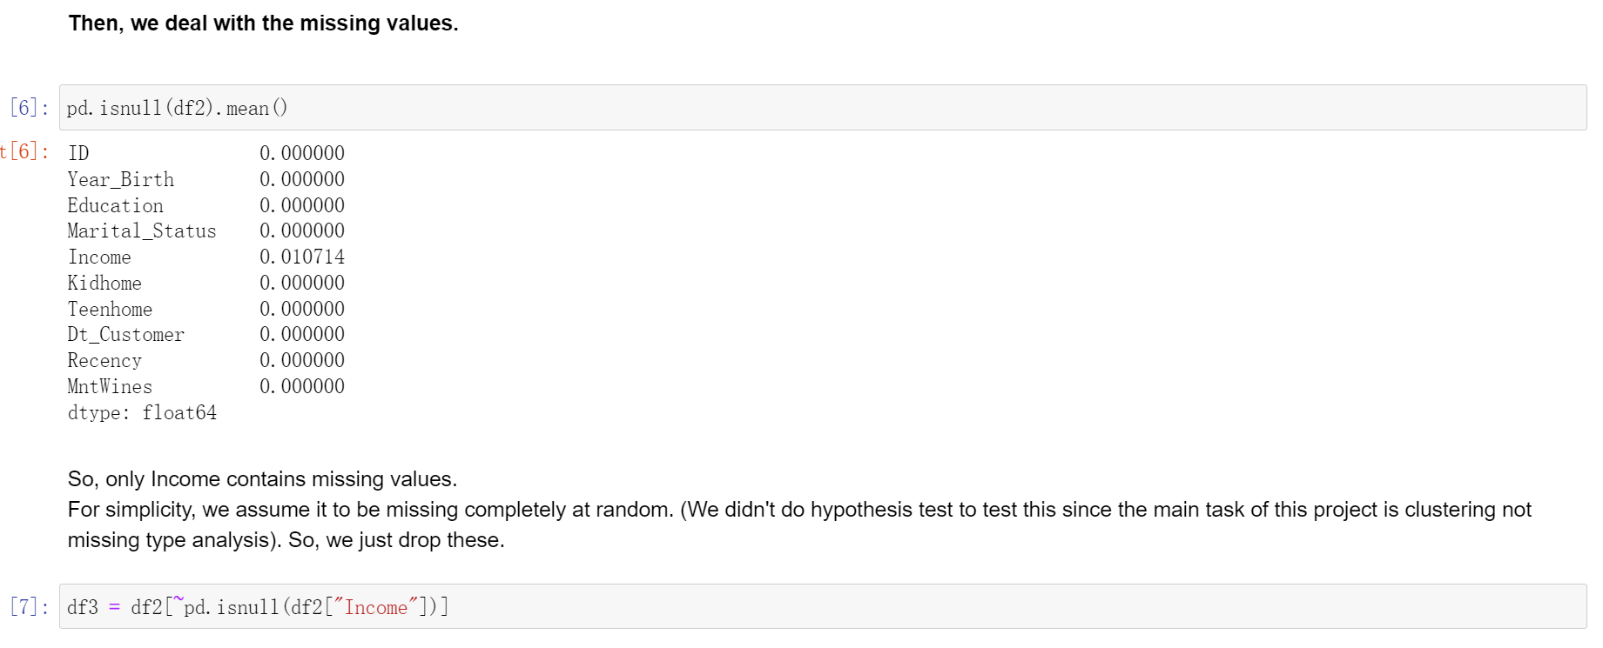
Process:
Data Cleaning
Step1: drop the columns that we will not use: we only choose the first ten columns because they are mostly numerical values.
Step2:we drop the rows that contain null values

Slide 18
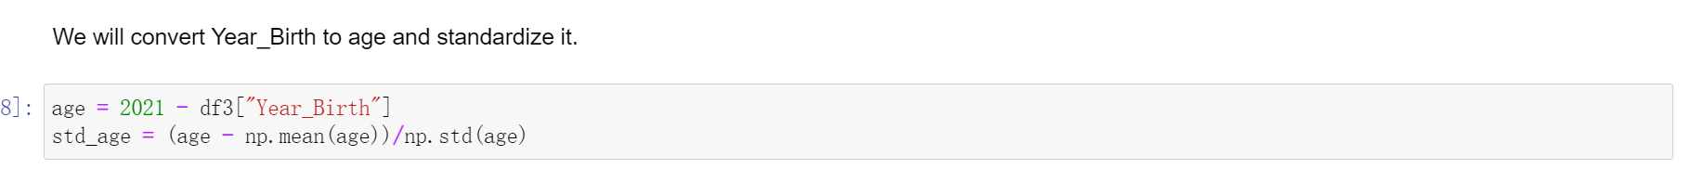
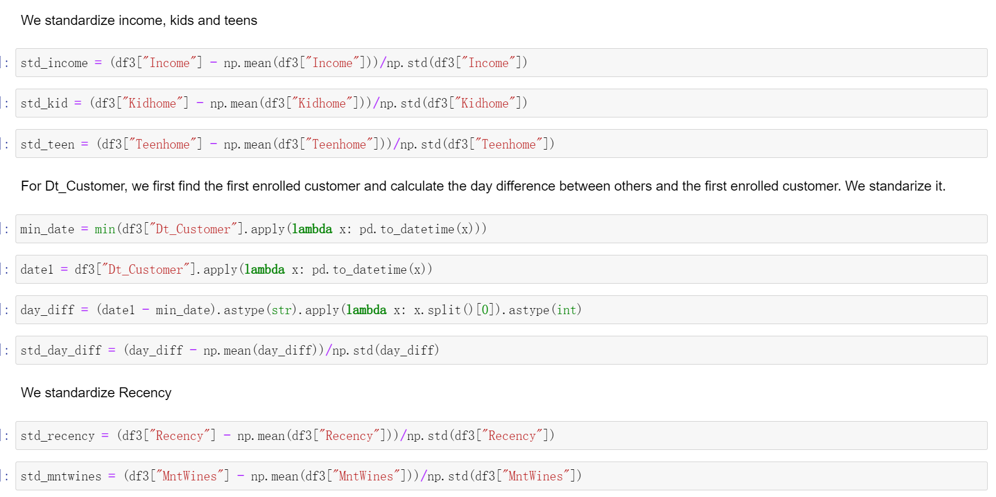
Data Cleaning
Step3: Convert the year into age and standardize it
Step4: Standardize other columns: teens, kids, income, recency
Note: We choose to standardize these dimensions because the scale of each dimension is different. Some features like income is around 50,000 but other features like kid is 0 or 1. Hence, if we do not standardize them, it will distort the dataset and influence the outcome of K-means

Slide 19
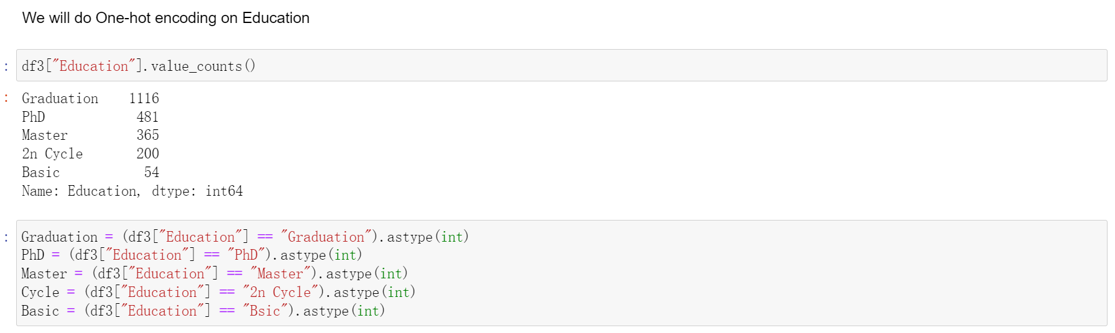
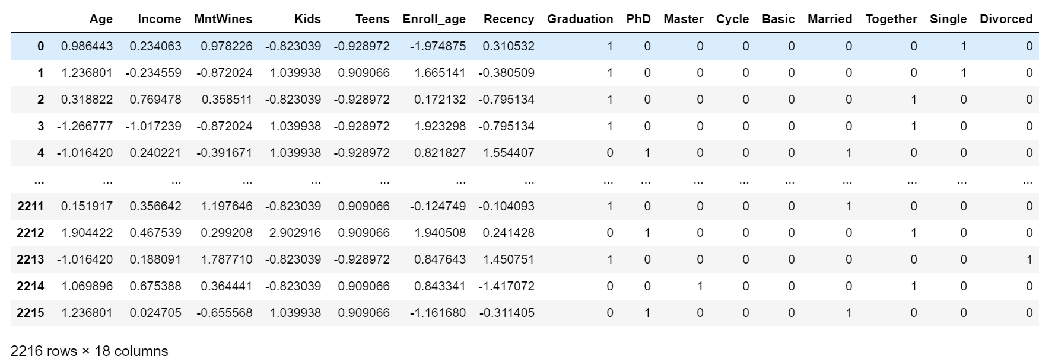
Data Cleaning
Step 5: Use one-hot encoding to convert non-numerical value into categorical data
Step6: dataset after cleaning

Slide 20
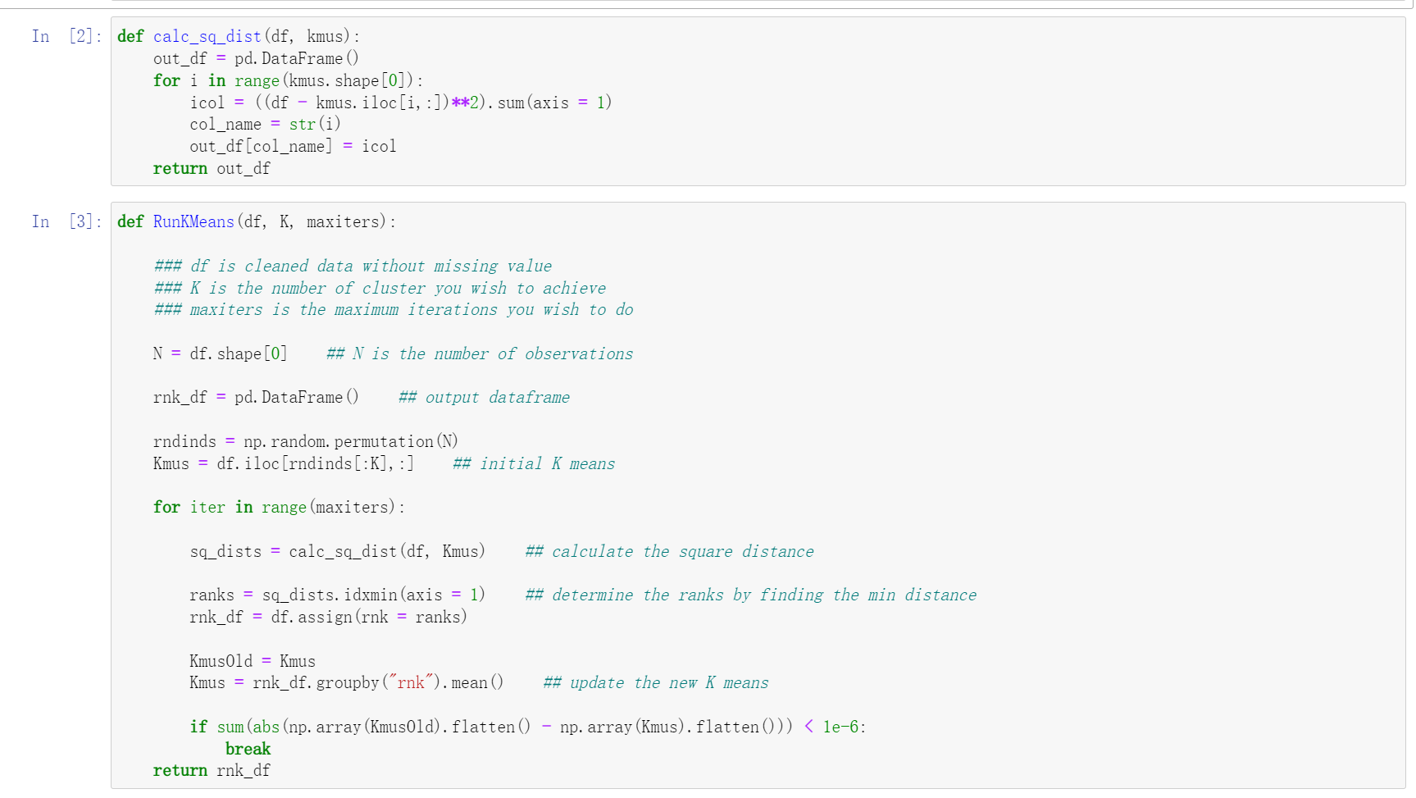
We wrote the K-means by hands

Slide 21
Without PCA
Now the first problem is: how do we determine k?
Because our data has more than two dimensions, it is hard to visualize them. However, there are several backup methods: Elbow, Silhouette, density graph, AIC (Akaike Information Criterion), and BIC (Bayesian Information Criterion).

Slide 22
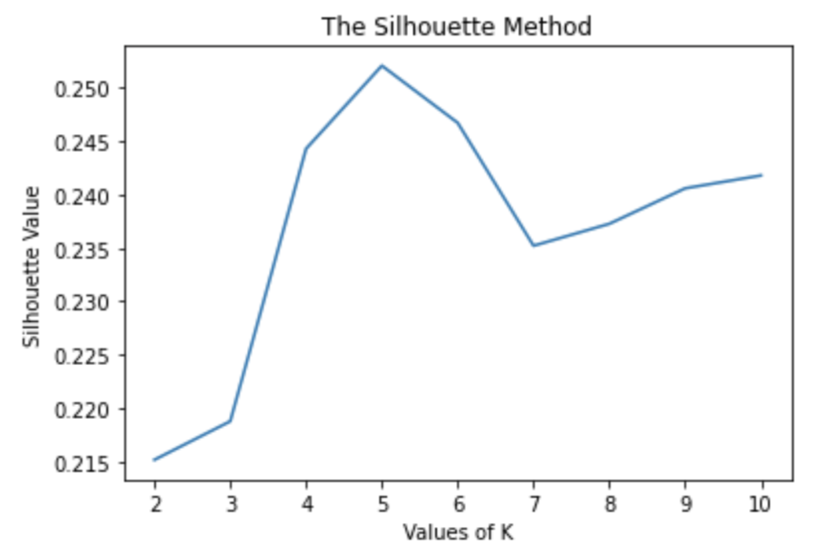
There are two possible optimal k by using Silhouette and Elbow.
a. Silhouette
"The Silhouette value measures how similar a point is to its own cluster (cohesion) compared to other clusters (seperation)." -- Wikipedia
The higher the Silhouette value, the better is the kmean algorithm.
We used silhouette_score in python.
The Silhouette value reaches its global maximum at the optimal k.
From the graph, the optimal k is 5.

Slide 23
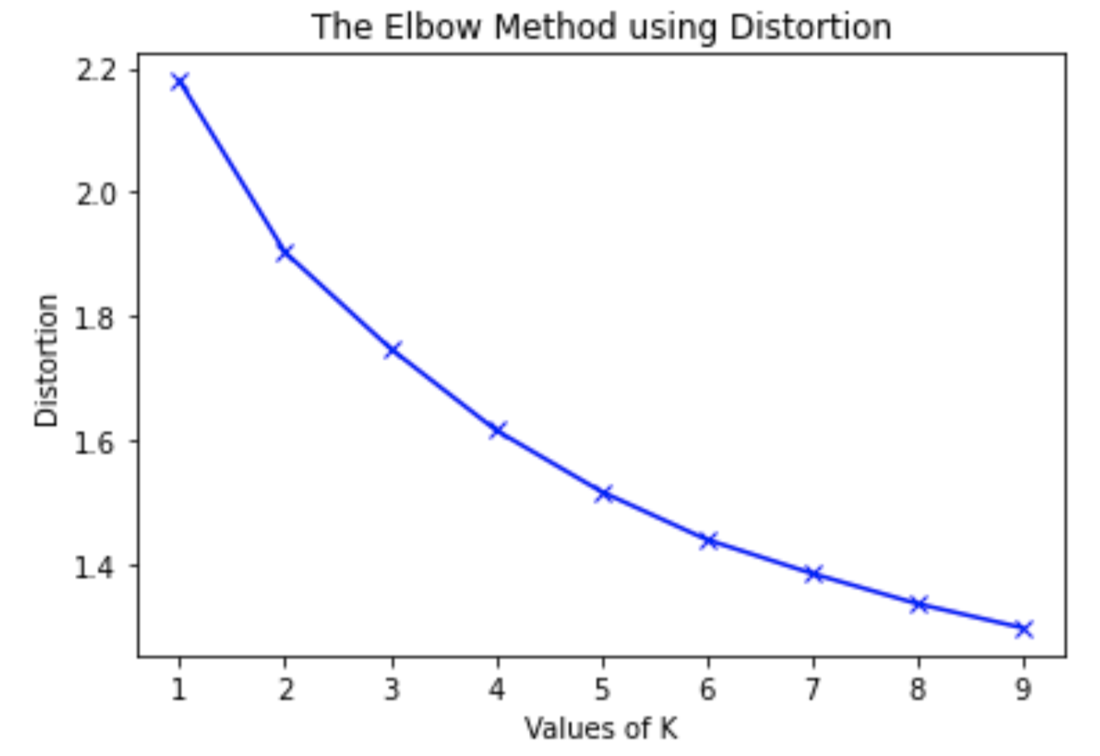
b. Elbow
The Elbow method measures the distortions (variances) of the k-mean.
We desire smaller distortions. However, as distortion is negatively related with the values of k, we should find the elbow point of the graph.
We used K-mean Model.inertia_ in python.
From the graph, the Elbow point is at 2. Thus, the optimal k is 2.

Slide 24
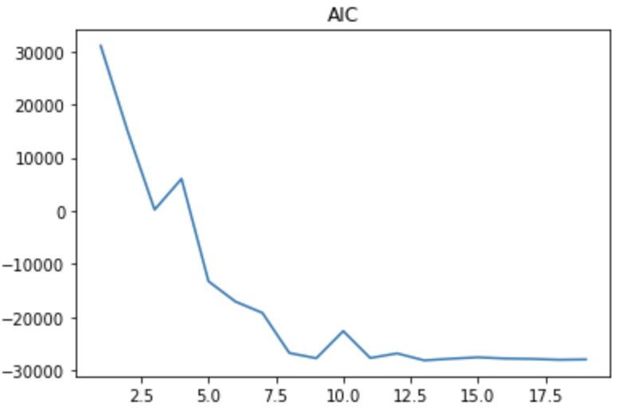
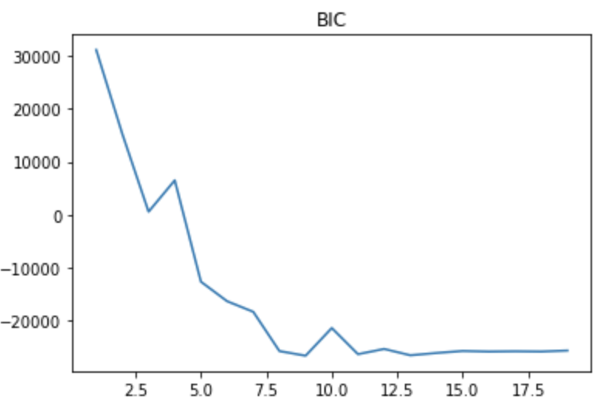
Other Methods (Akaike Information Criterion, and Bayesian Information Criterion):
These methods produce extremely large k values, which does not meet our expectations

Slide 25
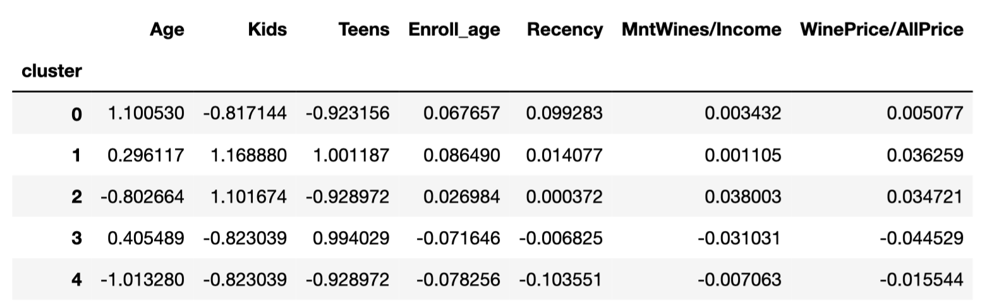
*The data represents the standardized means of each cluster. After comparison between k=2 and k=5, 2 clusters work better for our data.
2 clusters:
5 clusters:
There is little differences between these two clusters.

Slide 26
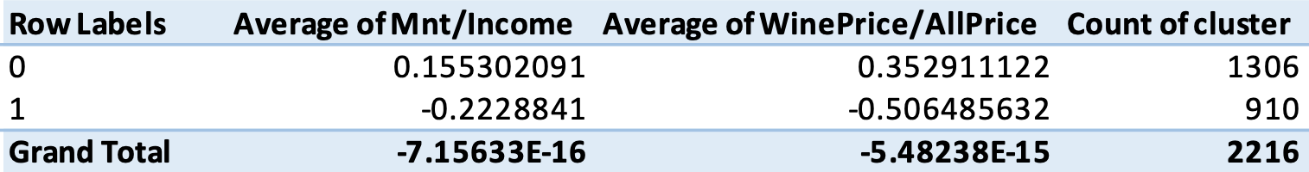
Overview of K-mean with 2 clusters
The two clusters separated by Kmeans show that cluster 0 tends to spend large proportion of their money on wines, and cluster 1 tends to spend smaller proportion of their money on wines.

Slide 27
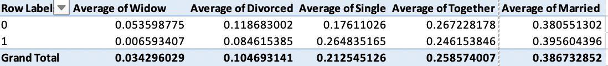
Cluster 0 is composed of 5.4% of widow, 11.9% of divorced, 17.6% of single, 26.7% of together and 38.1% of married. Cluster 1 is composed of 0.6% of widow, 8.7% of divorced, 26.5% of single, 24.6% of together and 39.6% of married
Notes:
5.4% of Cluster0 is made up of widow, 11.9% of Cluster0 is made up of divorced, 17.6% of Cluster0 is made up of single, 26.7% of Cluster 0 is made up of together, 38.1% of Cluster0 is made up of married.

Slide 28
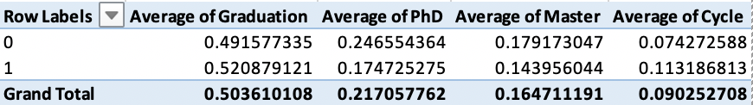
Cluster 0 is composed of 49.2% of graduation, 24.7% of PhD, 17.9% of master and 7.4% of cycle.
Cluster 1 is composed of 52.1% of graduation, 17.5% of PhD, 14.4% of master and 11.3% of cycle.

Slide 29
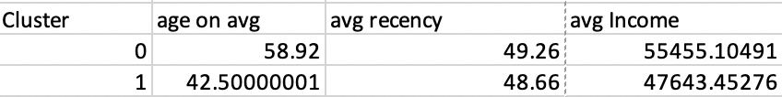
Result Analysis
We first look at the average of age, recency, and income for each clusters.
People who have higher income and larger age is likely to be in cluster 0.

Slide 30
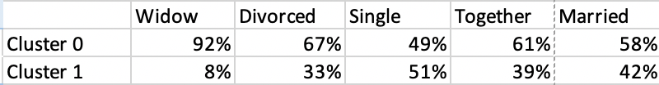
Result Analysis
We calculate the proportion of being cluster 0 and cluster 1 for each relationship state respectively.
If our future customer is widow, we have 92% possibility that he/she is from cluster 0. In other words, he or she has 92% possible to spend more proportion of their income on purchasing wines.
Similarly, it is more likely for a divorced, together or married customer to spend more income on wine, while it is less likely for a single customer to spend more income on wine.

Slide 31
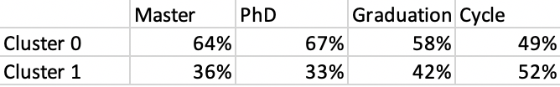
Result Analysis
We calculate the proportion of being cluster 0 and cluster 1 for each diploma respectively.
If our future customer is PhD, we have 67% possibility that he/she is from cluster 0. In other words, he or she has 67% possible to spend more proportion of their income on purchasing wines.
Similarly, it is more likely for a master or graduation customer to spend more income on wine, while it is less likely for a cycle customer to spend more income on wine.

Slide 32
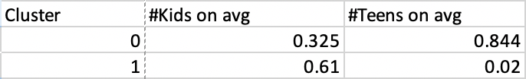
Result Analysis
We calculate the average number of kids or teens for cluster 0 and cluster 1.
If our future customer does not have kids, it is more likely that they will spend more proportion on wines. If our future customer have kids, it is more likely that they will spend less proportion on wines.
On the opposite, If our future customer does not have teenagers, it is more likely that they will spend less proportion on wines. If out future customer have teenagers, it is more likely that they will spend more proportion on wines.

Slide 33


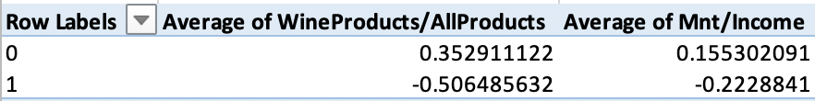
Result Analysis
Beside of looking at the characteristics of people in each cluster, we could also look at our two
measures, and
From the table, since has a larger range, which means that using this
index is more distinguishable compared to

Slide 34
Summary
Characteristics of People who are likely to have higher desire on purchasing wines:
People who are older around 59 years old
People who are richer around $55455 income
People who are widow
People who is PHD
People who has one teenager
We could also use to distinguish the clusters of each customer.

Slide 35
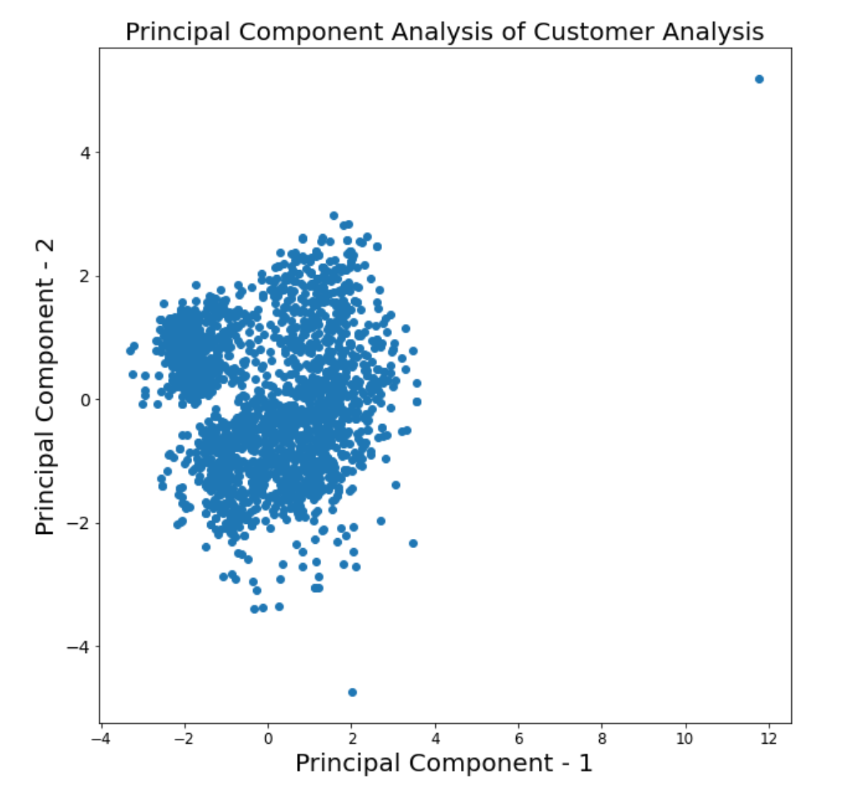
With PCA
Our first step is to decrease the dimensionality of the dataset. We reduce the number of principal components to 2, so we can visualize the dataset.
From the graph here, we can see that the general distribution of the dataset, and it approximately has three main clusters. Hence, our optimal k value could be 2 or 3.

Slide 36
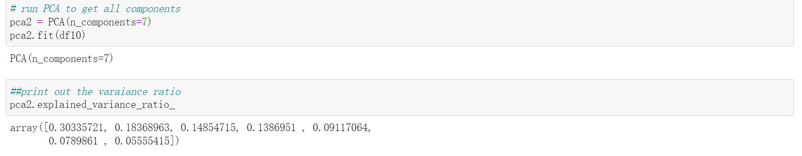
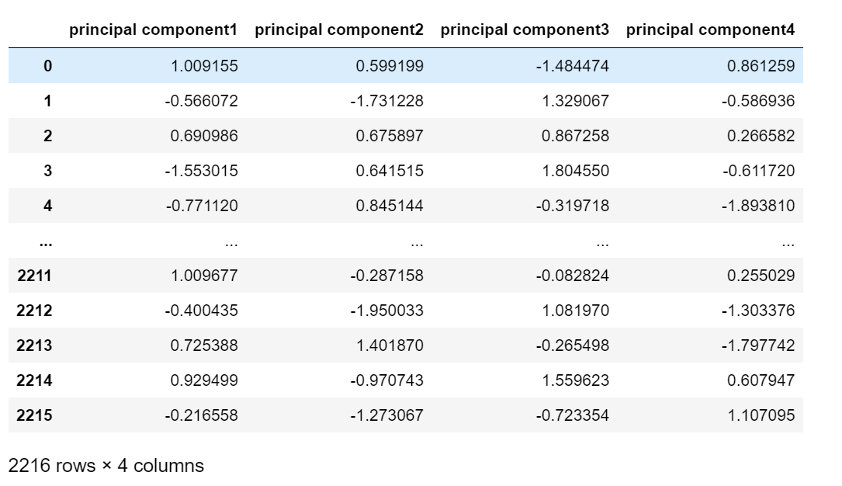
2. We run the PCA on all the components and see its variance ratio.
From the ratio, we can see that the first four columns have relatively large variance, while the last three are quite small. In this case, we decide to set the number of our principal components equal to 4.
3. Run the PCA and get the result
And we will use this dataset to run K-means

Slide 37
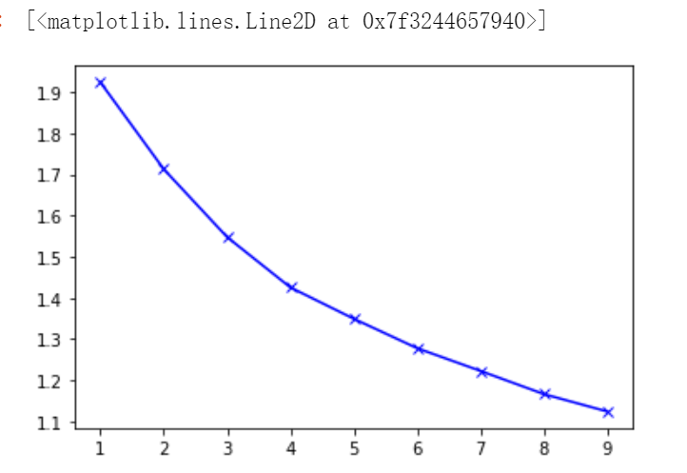
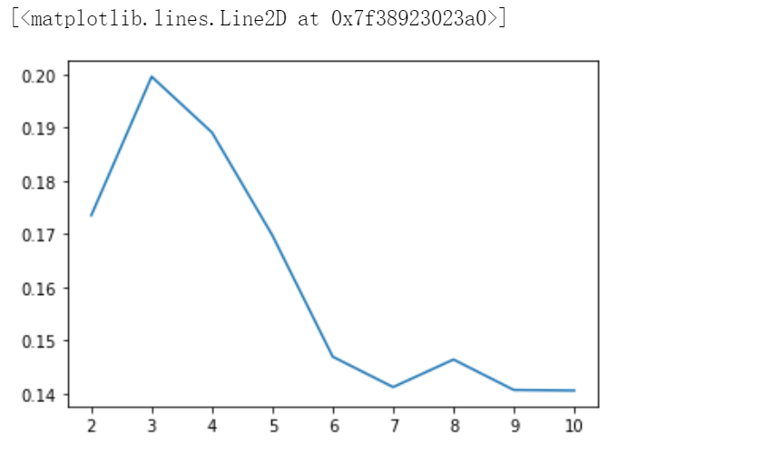
4. Use elbow graph to determine k value
5. Use Silhouette score to determine k value
From the graph, we can see that the elbow point is not very clear, so we choose silhouette score to determine the k value
From this graph, the silhouette score reach the maximum at k=3. Hence, our optimal k value should be 3, which corresponds to our prediction before

Slide 38
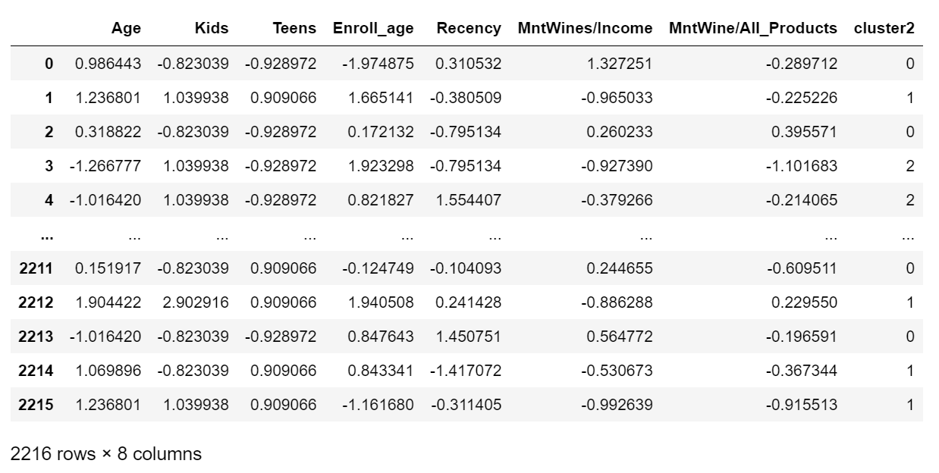
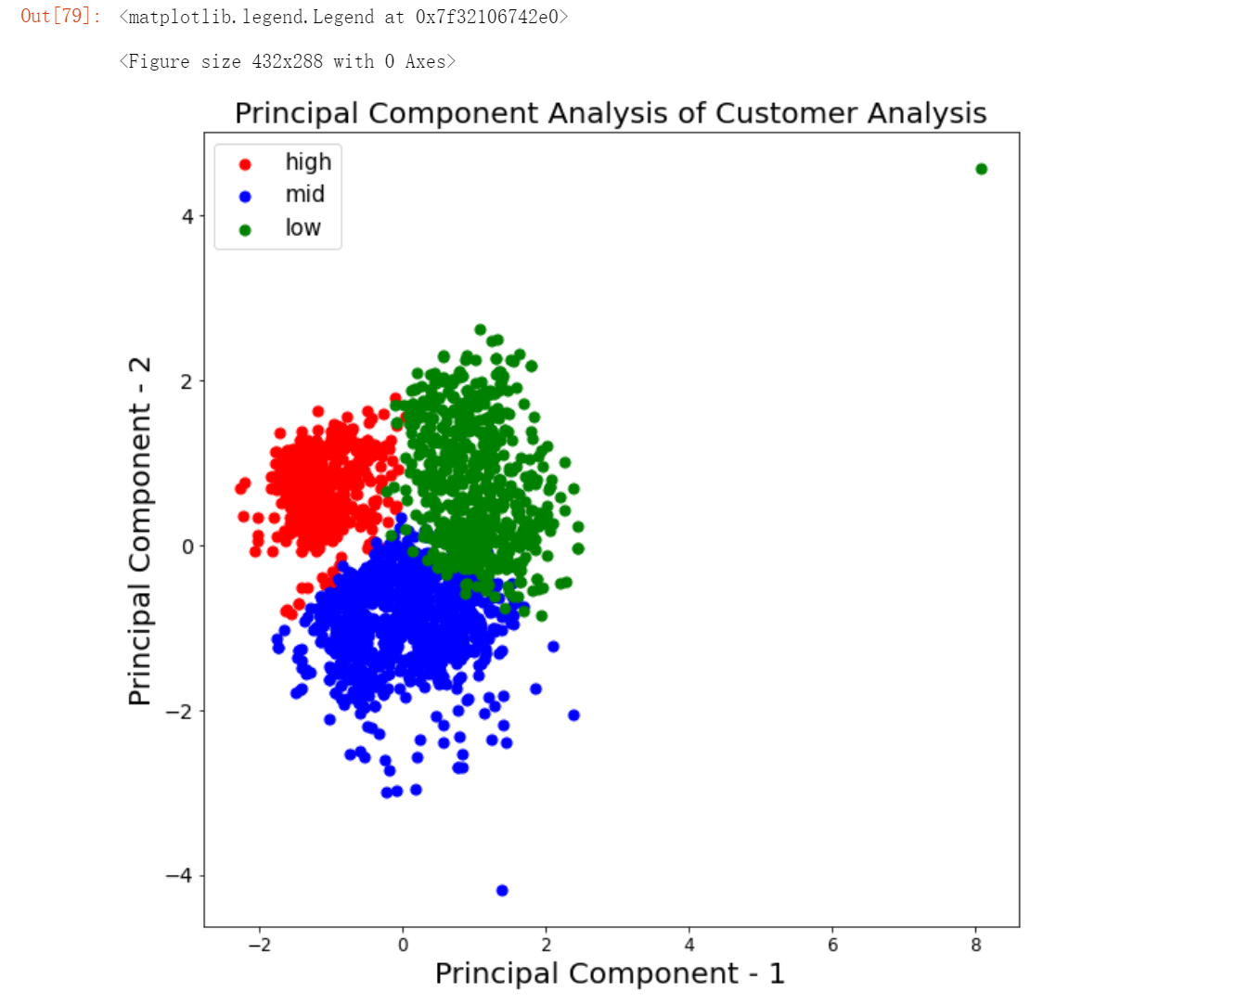
6. Run K-means on the dataset after PCA
7. Visualize the clustering
Note: Cluster2 indicates which cluster the customer belongs to. And the measures (6th and 7th columns) did not run through the Kmeans. they were appended later.
From the graph, we can see that the outcome of K-means is pretty good

Slide 39
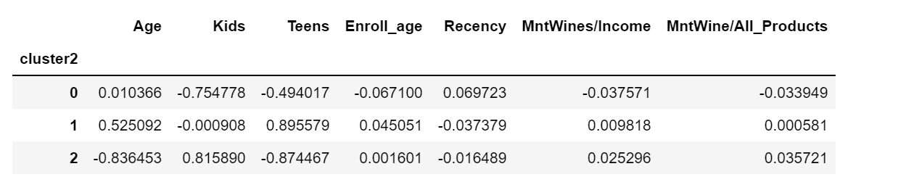
7. take a look at the mean

Slide 40
Result Analysis:
From the two measure columns (MntWine/Income, MntWine/All) in the statistics above, we can see that
Cluster0 = low willingness
Cluster1 = middle willingness
Cluster2 = high willingness
Moreover, we can convert the normalized data back to the original to see the patterns. Specifically, the group of customers with low willingness has a average age of 52, and most of them do not have kids. This clustering makes sense because most elder people did not drink much wine, less likely to purchase wine. However, for the customers with high willingness, they have average of 40, and most of them have kids. From the comparison, we may conclude that the younger customers have higher willingness of buying wine and they usually have kids. Maybe number of kids can indicate the richness of the family. Therefore, if we want to sell wine products, we should consider sending advertisements to younger customers who have kids.
Another pattern we can observe from the statistics is that compared with the customers with high willingness, customers with low willingness have small enrollment age and long recency. Low enrollment age indicates that they are new customers and long recency implies that their shopping frequency is low. Hence, when we sell our wine products, these customers should not be our primary target.

Slide 41
4. By comparing the two measure columns (MntWine/Income, WineProducts/AllProducts), we can discover that the second measure (WineProducts/AllProducts) has more differences between clusters. This means that the second measure can represent customers’ purchasing willingness in a more distinguishable way, which makes it a better measure compared with the first one (MntWine/Income).
5. Compared with the result from without PCA and with PCA, their patterns have some differences. For example, for without PCA, customers with high willingness of purchasing wine usually have larger age around 59. However, for with PCA, the customers with high desires of purchasing wine have younger age around 40. Thus, some of the patterns are similar, and others are different. We believe that this is because PCA exclude some dimensions, which influences the outcome of clustering. In conclusion, using PCA before K-means is not very appropriate, which will affect the clustering.

Slide 42
Discussion
What did we learn?
The whole process and the difficulties we may have of K-mean algorithm
The problems may exist in unsupervised learning.
Lessons from PCA
What could we do better?
Measures selection
Processing categorical data
Supervised learning
Choose dimensions

Slide 43
The whole process and the difficulties we may have of K-mean algorithm
What did we learn?
In this project, we get a chance to go through the whole process of K-mean algorithm. First, we should properly select the data and we know from this project that the binary variable (0-1) cannot be taken into K-mean algorithm. After that, we should determine the proper k and we may have difficulties in this part because Elbow taught in the lecture may not always work. To overcome the difficulties, we learn that PCA or other k-determining methods (such as AIC, BIC, Silhouette, etc.) would work. Finally, because K-mean algorithm is an unsupervised learning algorithm, we should figure out the patterns of each cluster.

Slide 44
2. The problems may exist in unsupervised learning
What did we learn?
The algorithm we used in this project are all unsupervised learning algorithms. Unlike supervised learning, we cannot collect or produce data from the previous experience.
One thing we learned from the this project is that most of the time unsupervised learning don’t classify the data into clusters that we familiar with, we have to look carefully into each cluster to find the underlying pattern the algorithms have found out. The first few times of clustering may be unintuitive but all we need to do is to try different value for k until we find a significant difference.

Slide 45
3.Lessons from PCA
What did we learn?
In this project, we use PCA to reduce the dimension of the original dataset and run K-means on that. But the result does not meet our expectation. PCA has some influences on the outcome of clustering. As professor mention in the class, PCA will exclude several dimensions and rotate the dataset to reduce the dimension. And this could be regarded as the primary reason why the clustering result is not good. However, PCA proves to be very useful in visualizing high dimensional data. As you can see in the previous slides, PCA allows us to visualize the clustering result of K-means, which is clear and easy to comprehend. In conclusion, we should be more careful when we use PCA to reduce the dimensionality of the dataset. Even though it contains the maximum variance, it still modify the dataset to some extent.

Slide 46
4. Multiple ways to choose optimal k
What did we learn?
In this project, we use Elbow, Silhouette, AIC(Akaike Information Criterion), and BIC(Bayesian Information Criterion) respectively to find the optimal k. Though there are different methods, each method indicates different optimal k. Thus, we need to try each method and find which optimal k is truly optimal for our dataset.

Slide 47
Measure Selection
What could we do better?
In this project, we only use two measures to represent customer’s willingness to purchase wine: MntWine/Income and WineProducts/AllProducts. In our project plan, we expect to use about 4 or 5 measures to represent the purchasing willingness and compare their outcomes to see which one is the most representative. Hence, if we are given with more time, we should come up with more measures to make the project less biased and more convincing. Moreover, we can invite the students who have deep understanding in statistics, and he can give more valuable and reasonable measures.

Slide 48
2. Processing categorical data
What could we do better?
We used one-hot coding to encode the categorical data. For example, married will be 1 and not married will be 0. However, encoding in this way has a problem: we cannot run K-means on categorical variables because computing Euclidean distance for such data is meaningless. to solve this problem, we may need to adjust our K-means algorithm. After some research, we found that an algorithm called K-mode may help us. Hence, if we have more time, we would like to use this algorithm to process categorical data and observe its effect.

Slide 49
3. Supervised learning
What could we do better?
Another improvement that we can do is supervised learning. Classification by using unsupervised learning may not always classify the data in the way we want. In this case, we want to find purchasing willingnesses of each group are distinguished from each other. But the unsupervised learning cannot always satisfy our requirement.
Hence, what more we can do is to split our dataset into training part and testing part. We run the K-means on the training part to cluster the customers and summarize its patterns; then, we apply these patterns to the test part to predict which cluster they belong to and we can see if they really belong to this cluster. In this way, we can judge the accuracy and effectiveness of the Kmeans, which will make our project more meaningful.

Slide 50
4. Choosing Dimensions
What could we do better?
Another improvement that we can make is to try different combinations of dimensions. In this dataset, there are 7 dimensions that we can use. thus, when we run the Kmeans, if we include or exclude several dimensions, the outcome of the Kmeans will also change. We should try different combinations of the dimensions to see which one will make a better clustering. this part is very time consuming because we may need to try about 50 kinds of combination and see their outcomes.

